Slide 1

Architecture Study

Slide 2
Architecture Study
Multi-tier or N-tier

Slide 3
Basic Concepts
N-tier architecture is also called multi-tier architecture because the software is engineered to have the processing, data management, and presentation functions physically and logically separated. That means that these different functions are hosted on several machines or clusters, ensuring that services are provided without resources being shared and, as such, these services are delivered at top capacity. The “N” in the name n-tier architecture refers to any number from 1.
Not only does your software gain from being able to get services at the best possible rate, but it’s also easier to manage. This is because when you work on one section, the changes you make will not affect the other functions. And if there is a problem, you can easily pinpoint where it originates.
N-tier architecture would involve dividing an application into three different tiers. These would be the
logic tier,
the presentation tier, and
the data tier

Slide 4
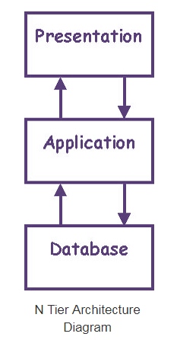
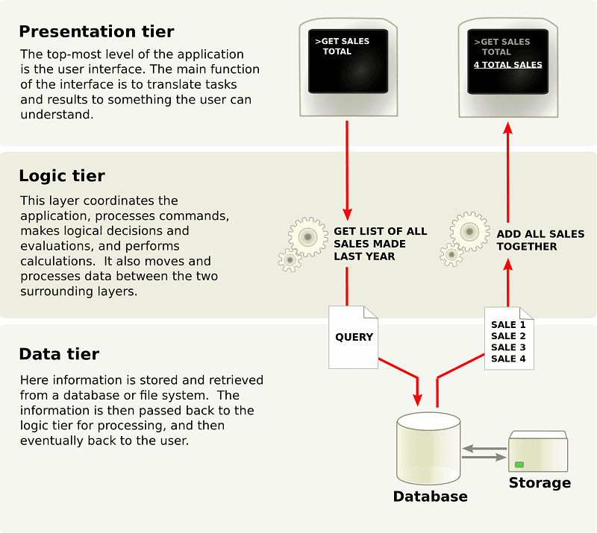

Slide 5
Benefits of N-Tier Architecture?
There are several benefits to using n-tier architecture for your software. These are scalability, ease of management, flexibility, and security.
Secure: You can secure each of the three tiers separately using different methods.
Easy to manage: You can manage each tier separately, adding or modifying each tier without affecting the other tiers.
Scalable: If you need to add more resources, you can do it per tier, without affecting the other tiers.
Flexible: Apart from isolated scalability, you can also expand each tier in any manner that your requirements dictate.
More efficient development: N-tier architecture is very friendly for development, as different teams may work on each tier. This way, you can be sure the design and presentation professionals work on the presentation tier and the database experts work on the data tier.
Easy to add new features: If you want to introduce a new feature, you can add it to the appropriate tier without affecting the other tiers.
Easy to reuse: Because the application is divided into independent tiers, you can easily reuse each tier for other software projects. For instance, if you want to use the same program, but for a different data set, you can just replicate the logic and presentation tiers and then create a new data tier.

Slide 6
Further Reading
https://stackify.com/n-tier-architecture/

